Slide 1


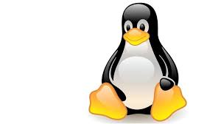
Geon online session -2
Introduction to MQTT protocol..

Slide 2
What is MQTT ??
MQTT == Message Queue Telemetry Transport
“A light weight event and message oriented protocol allowing devices to asynchronously communicate efficiently across constrained networks to remote systems”.
It is a light weight “publish and subscribe” messaging protocol, which means any other device can subscribe to a particular topic as “publish and recieve”
It establish communication between multiple devices
Simple messaging protocol designed for
- constrained devices
- desgined for devices which run on low power and low bandwidth.
Perfect solutions for “Internet of things” applications..

Slide 3
Why isn’t HTTP enough?
The HTTP standard revolutionized how people
consume data.
– A single simple model: Send a request, read the response
– Available via any tablet, laptop, phone, PC etc.
The Internet of Things has fundamentally different
challenges
– HTTP remains ideal for requesting data from a known source
Emitting information one to many
Listening for events whenever they happen
Distributing minimal packets of data in huge volumes
Pushing information over unreliable networks

Slide 4
MQTT is an application layer protocol as http protocol
however significant difference b/w both the protocols .
Http is not specifically desgined for M2M communication.
Lot of IOT projects work under variety of constrained conditions such as,
-Memory limitations
-Unreliable networks
-Energy constraints
-Limit process capability..
In such conditions Mqtt is preferred over Http.

Slide 5
MQTT Basic Concepts
Publish / subscribe
Messages
Topics
Broker
These are the few concepts in mqtt protocol for machine to machine (M2M) communications.
In most of the cases we use publish/subscribe and broker for the larger applications

Slide 6
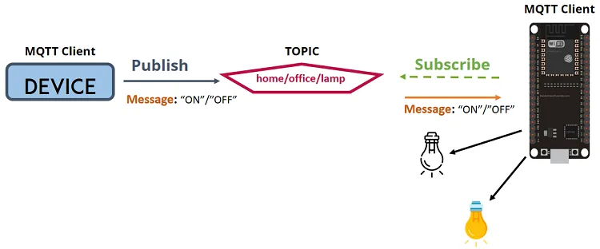
Publish/Subscribe
Device 1 publishes a topic
Device 2 is subscribed to the same topic in which device1 is publishing in
Device 2 recieves the message
(Messages: information exchanged between your devices -command or data.)
By the help of this system we can do anything for home-automation projects.

Slide 7
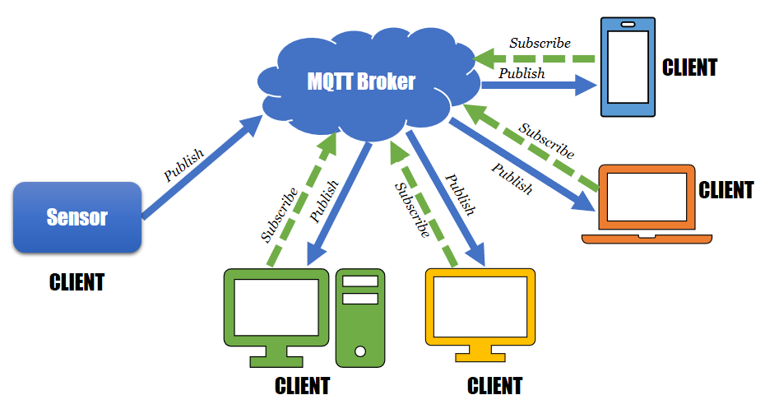
MQTT Broker
Recieves all the messages
Filters the messages
Publishes the messages to all the subscriberd clients.
Eg: Mosquitto broker

Slide 8
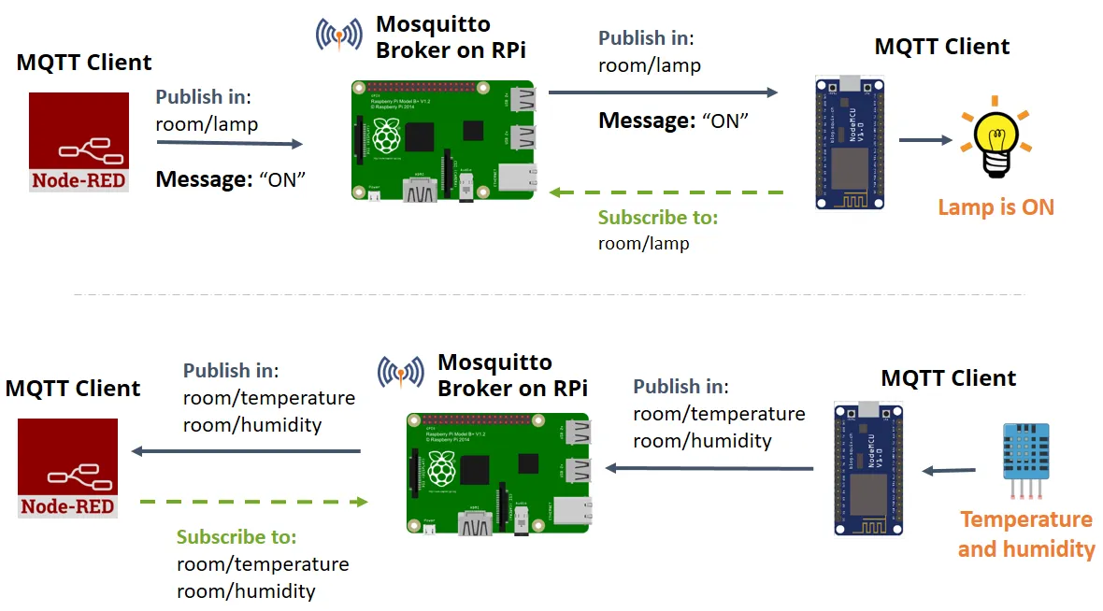
MQTT- How its works
Send a command to control an output
Read and publish data.

Slide 9
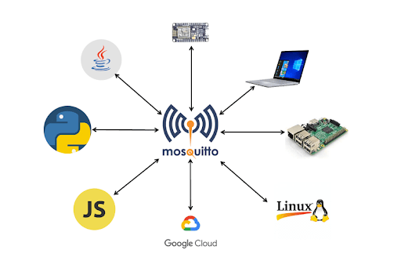
MQTT implementation
Server implementation – Cloud MQTT .
Client implementation –ESP8266, Paho provides open source client .

Slide 10
Some areas where MQTT has been used:
Environment &Traffic Monitoring
Home Automation
Railway department
Asset tracking / management
Slot Machines
Automotive/Telematics
Medical department
Chemical industry..

Slide 11
MQTT technology
In Paho
– Java, JavaScript C and Lua client libraries Utilities
Others client libraries outside Eclipse
– Python, Perl, Ruby...
– See https://mqtt.org/software for a list
Server implementations
– Also https://mqtt.org/software

Slide 12

THANK YOU
For
LISTENING

